Slide 1


HPCViz: Monitoring Health Status of High Performance Computing Systems
Presenter
Dr. Tommy Dang
Assistant Professor, Texas Tech University
Faculty
Dr. Yong Chen
Associate Professor, Texas Tech University
Dr. Allen Sill
HPCC Managing Director, Texas Tech University
Industry
Jon Hass
Software Architect at Dell Inc.
PhD Students
Vinh Nguyen
Ghazanfar Ali
Vung Pham

Slide 2
Outline
Introduction
Background and related work
Visualization architecture
Demo
Future work

Slide 3
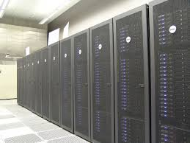



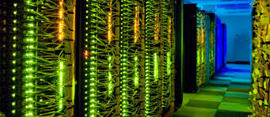
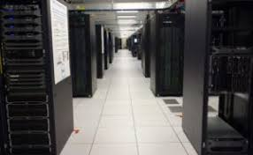
Introduction
Introduction
HPCC – Texas Tech University
Hewlett Packard Enterprise
IBM.com
Intel.com
HPC - Southern California
Dell EMC

Slide 4
Project Overview
Monitoring data centers is challenging due to their size, complexity, and dynamic nature.
This project proposes visual approaches health service monitoring of HPC systems.
The visualization is expanded on the following dimensions:
HPC spatial layout
Temporal domain (historical vs. real-time tracking)
System health services such as temperature, memory usage, fan speed, and power consumption.

Slide 5
Project Overview
We therefore focus the following design goals:
Provides spatial and temporal overview across hosts and racks,
An interface that allows viewers to quickly narrow down features or event of interest
Easy to switch and compare between different health status of HPC centers

Slide 6
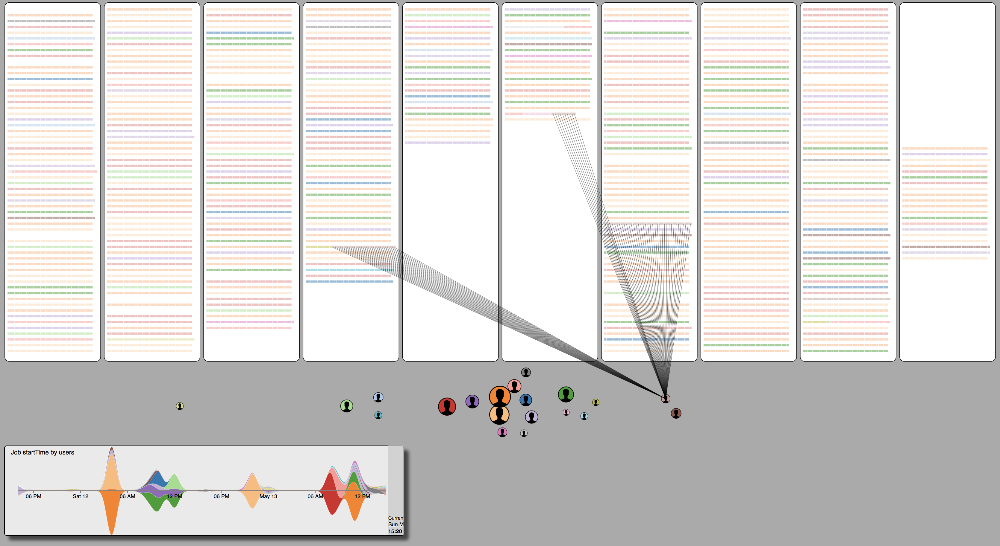
HPCC spatial layout and job scheduling
Demo: https://idatavisualizationlab.github.io/HPCC/scheduling/

Slide 7
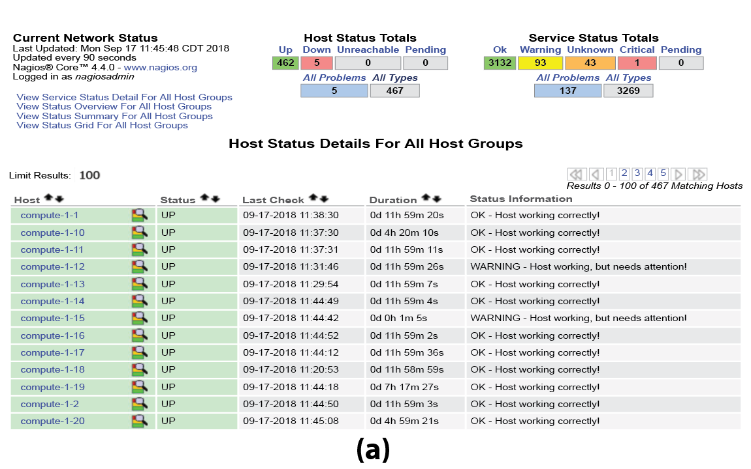
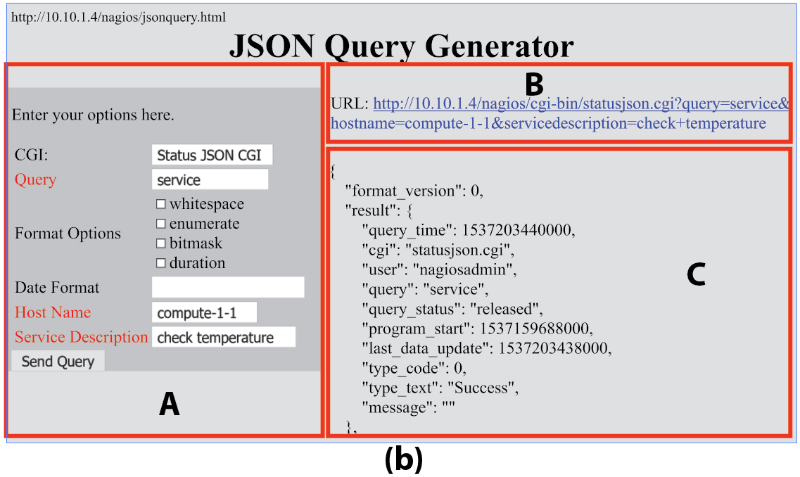
Background and Related Research
Notes:
a priori approach – instead of establishing a research question prior to performing an experiment, we let the data tell us which variables are important

Slide 8
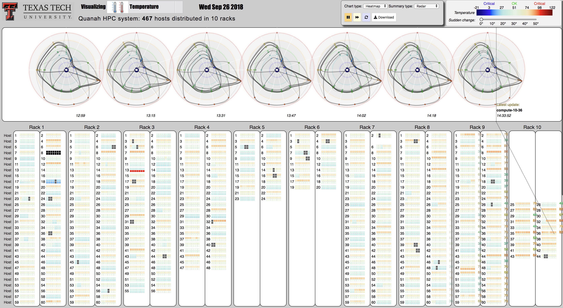
Background
Notes:
a priori approach – instead of establishing a research question prior to performing an experiment, we let the data tell us which variables are important

Slide 9
An initial interface has been developed

Slide 10
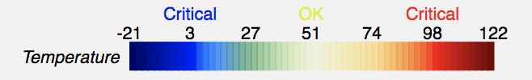
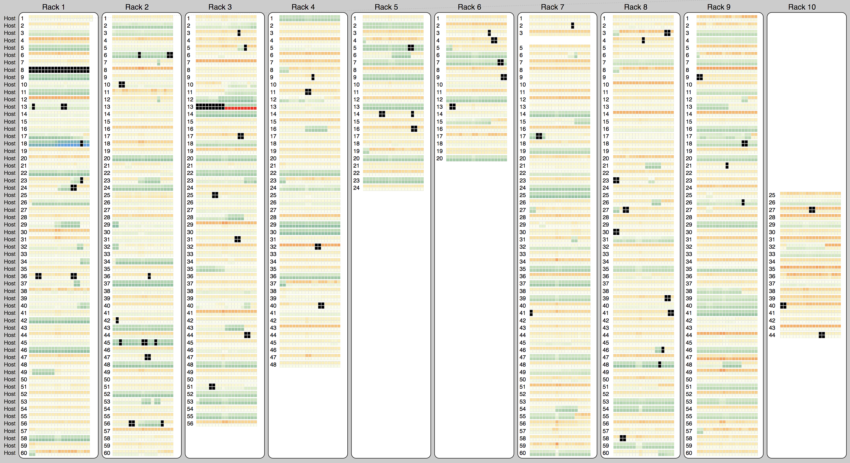
HPCC on Sep, 26 2018: CPU temperature

Slide 11
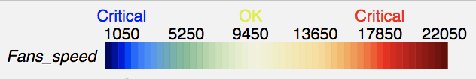
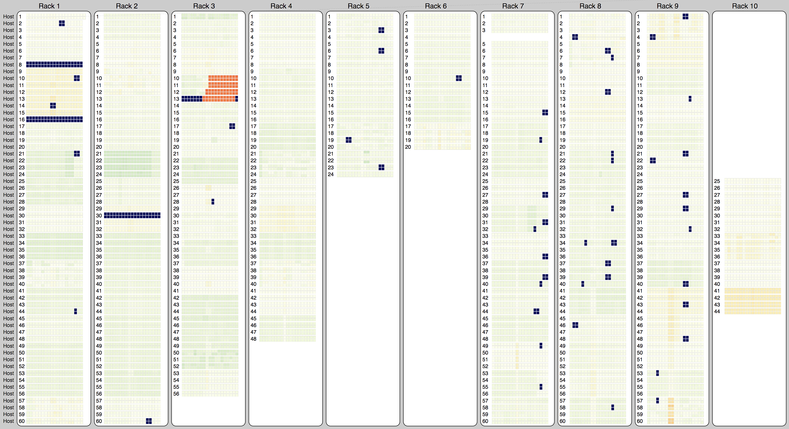
HPCC on Sep, 26 2018: Fan speed

Slide 12
Demos
HiperView:
https://idatavisualizationlab.github.io/HPCC/HiperView/demo.html
https://idatavisualizationlab.github.io/HPCC/HiperOverheatSep26/demo.html
Github repository:
https://github.com/iDataVisualizationLab/HPCC
Outlier detection:
https://outliagnostics.github.io/demos.html
Notes:
Will talk about each project individually
Dissemination: Drew’s poster is on risk simulation in colon/rectal cancer, which we will be investigating at the zip code level instead of county level
Aakriti’s paper on transdisciplinary teams, which has been presented at previous CAC meetings

Slide 13
Ongoing Work
The current prototype is very different from what we have in the paper

Slide 14

Questions?
Email: Tommy.Dang@ttu.edu

